Slide 1
Project – 2 Data Harmonization
Presented by:
Khushnaz
Date :
Place: next hikes

Slide 2
Introduction
Objective:
This project is main aim object“data preprocess, visualize, and merge dataset for generating actionable insights.”
Scope:
Mention datasets used and their relevance
Outline the key steps:
Preprocessing, Visualization, and merging

Slide 3

Work flow 1) Preprocess Dataset -1 2) Visualize Dataset-1 3) Preprocess Dataset-2 4) Visualize Dataset-2 5) Merge Dataset-1 and dataset-2 6) Preprocess And Visualize merging data 7) Preprocess Dataset-3 8) Visualize Dataset-3 9) Integration of dataset3 and merging data 10) Final Preprocessing and Visualization

Slide 4
Dataset-1 Preprocessing: Key Steps: 1) Data loading info: ,head, tail, describe, duplicates. Handle Missing data, data cleaning ,outliers , drop unnecessary value, frenheit. 2) Feature Engineering: extract .features 3) Normalization/Scaling. Tools/Technologies: tools like uses Python,( pandas, NumPy, matplotlib, excel, seaborn), SciPy , etc. Before and after Snapshot: show a table or graph highlighting raw vs. Cleaned data.

Slide 5
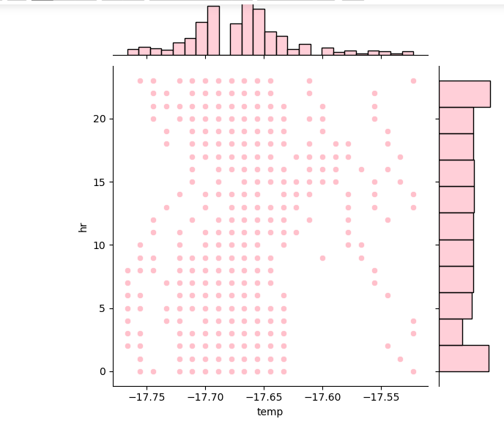
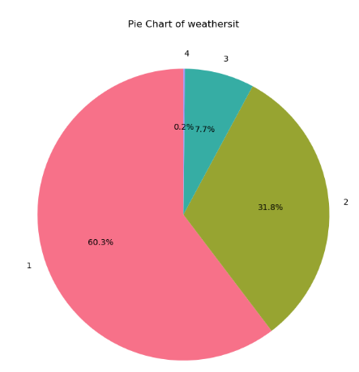
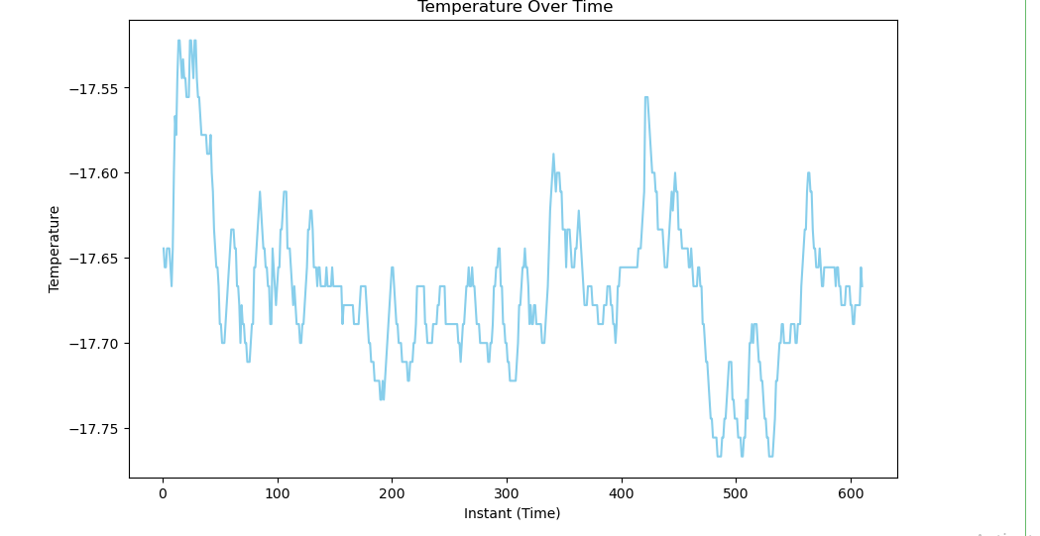

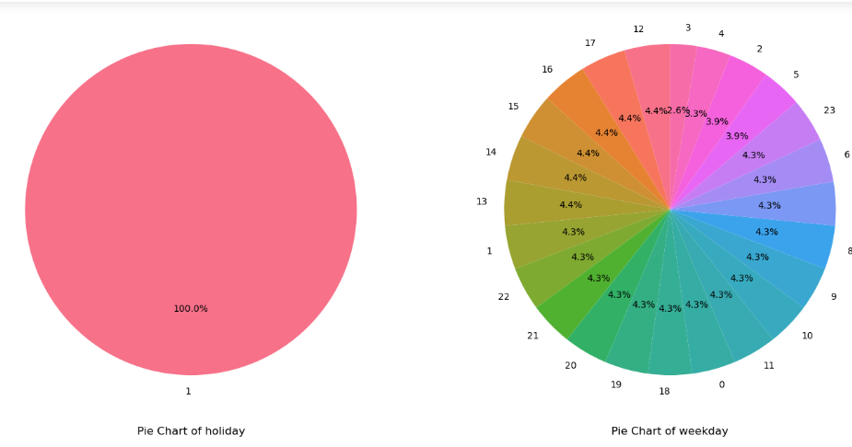
Dataset-1 Visualization:. key observations : Hourly trend: Temperature lowest during early mooring(0-6 Am). Peaks in the afternoon (12-15 hours). Seasonal Impact: season 1 (likely winter) has consistently lower temperatures. Weather Conditions: Majority of data recorded under favorable weather (clr skies) Weekday Trends: Minimal variation in patterns across weekdays. Insights: Seasonal Analysis: Analysis temperature variations for each season to identify seasonal trends. Hourly Study: Explore the impact of hourly tempuras trends on daily activates Graph/ Charts: Histogram plot , Bar Chart , Pie chart , Join plot , Line plot
join plot
Line plot

Slide 6
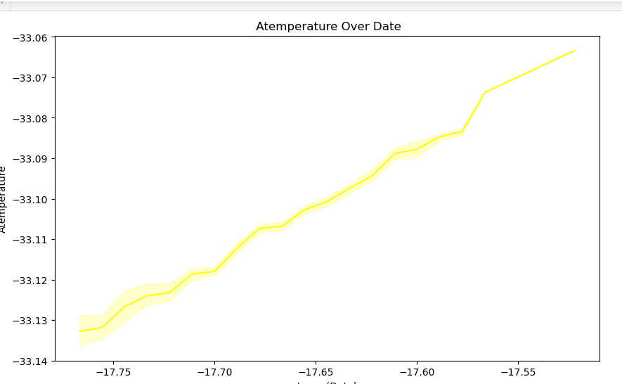
Dataset – 2 Preprocessing Same structure follow as slid 4, customized for dataset-2 Dataset – 2 Visualization Same structure follow as slid no 5 , customized for dataset-2 Merging Datasets: Process: 1) Handing Missing data fill or remove row with missing values in columns 2) Data Transformation: Normalize/standardize numerical values like temp , atemp and Encode categorical data (season , holiday , etc) 3) Features Engineering: Extract features from dteday, like day of the week, month , hour tool / technologies same dataset1 Visualization insights: key 1) temperature Trends Over time : type Line plot insight: Temptures fluctuates across the day and varies by season

Slide 7
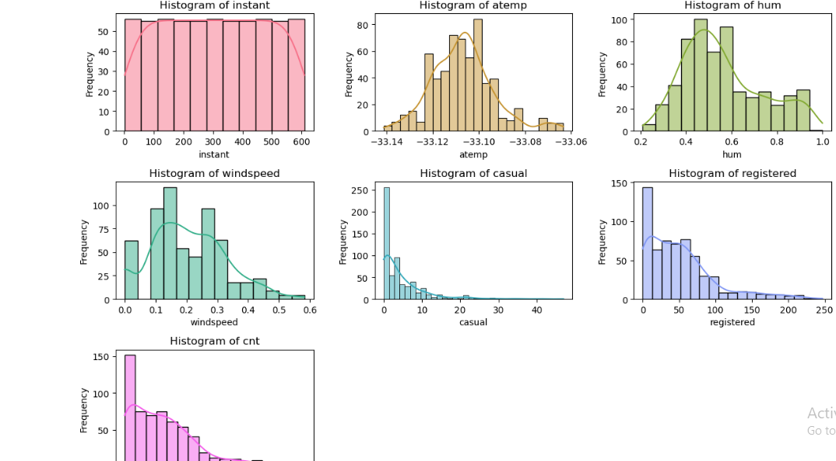

2. Seasonal comparison: type histogram plot insight Higher rentals observed in summer and spring seasons weather impact on rentals type Bar chart/pie chart insight clear weather increase rentals while poor weather reduce rentals weekday vs weekend trends: type Bar chart

Slide 8
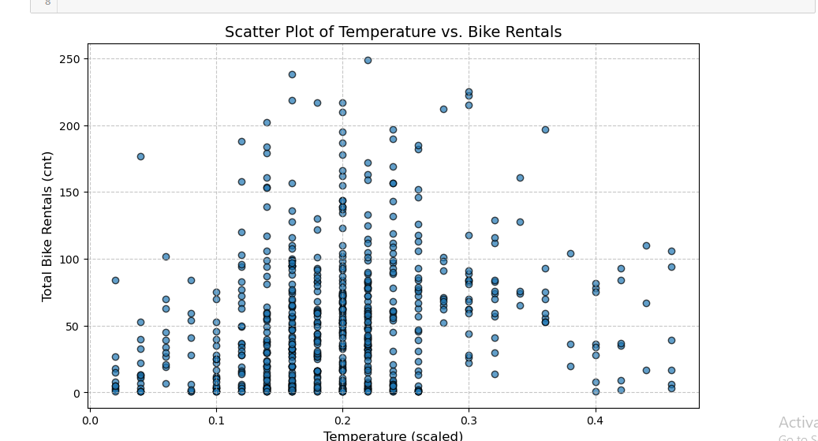
Integration of Dataset-3 Process: dataset – 3 me concatenation logic use this concatenation : Combine data from multiple sources for a comprehensive analysis and all method same tools Used: same tools used Snapshot Before and after concatenation: Visualization dataset3. Same process like dataset – 1

Slide 9
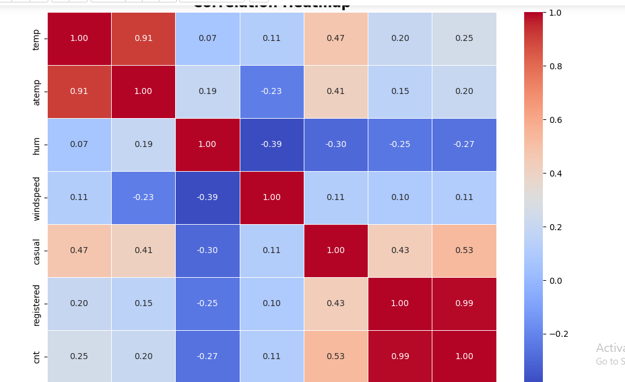
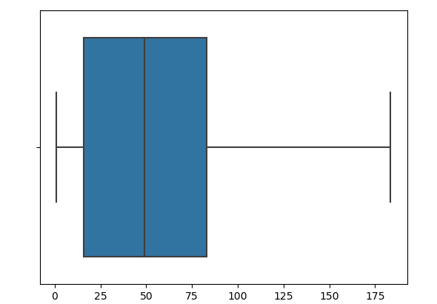
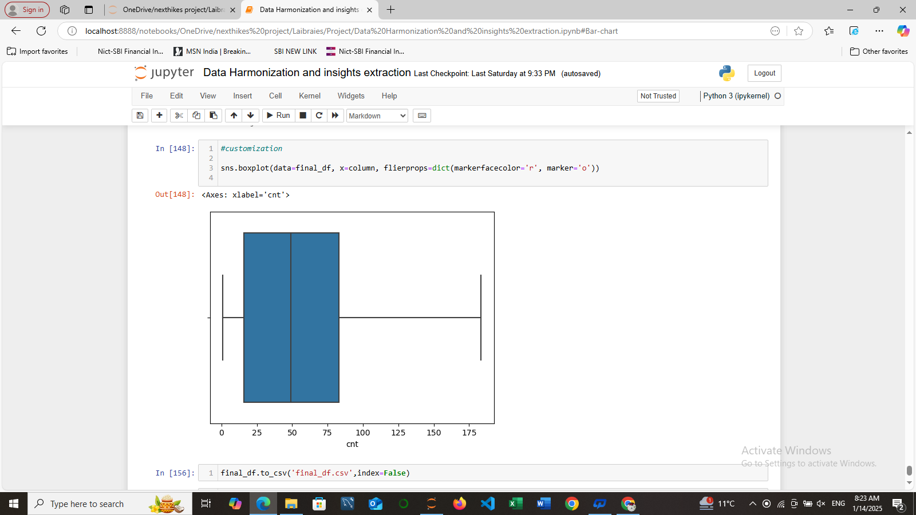
Final Preprocessing and visualization: final process me all type is same data process and visualization is same data but some changes so write here key values : . Preprocessed the dataset by clearing, transforming and creating new features for better analysis. . Visualization revealed clear trends in seasonal demand, hourly activity, and the impact of weather on rentals. . Insights are critical for understanding user behavior and optimizing resources. Visualization : all data type is same but heatmap correlation matrix, trend analysis final data me so and Box plot addd
Heatmap correlation
Box plot

Slide 10
Challenges and Solutions . Challenges Faced: Missing data, format inconsistences , etc. . Solutions Implemented: Describe strategies like imputation, scaling , etc

Slide 11
Future Scope 1) Predictive Analytics Develop models to predict bike rental based on weather and time 2) Demand Optimization: Analysis data to optimize bike availability in high demand areas. 3) Real- Time Monitoring: Implement dashboards for tracking rentals and weather conditions. 4) Environments Benefits: Asses the impact of bike rental on reducing carbon emissions.

Slide 12
Conclusion
The dataset was successfully preprocessed by handling missing data, outliers, and transforming features.
Visualizations revealed key insights into temperature trends, seasonal demand, and the impact of weather on bike rentals.
The analysis highlights the importance of data-driven decision-making for optimizing bike-sharing systems.
Future enhancements can include predictive models and real-time monitoring for better service efficiency.

Slide 13
Thank you

